Slide 1
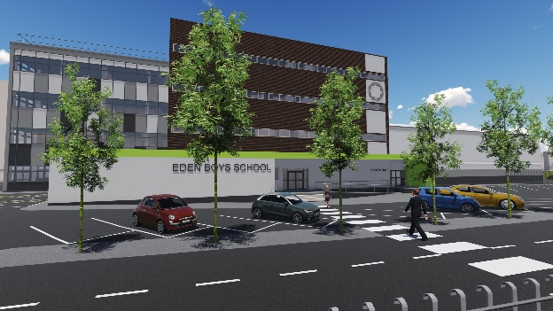
Eden B’ School Preston Year 9 and 10 Pupil Curriculum and Assessment Information 2017

Slide 2
Home School Partnership
PARENT
SCHOOL
PUPIL

Slide 3
National Change - GCSEs will be more difficult in content, tests and pass marks
‘Old’ GCSEs | New GCSEs
Modular exams | Linear exams - All exams completed at the end of the course
Opportunity to re-sit/ re-take exams modules | Re-sits and re-takes abolished
Controlled Assessment counting towards the final GCSE grade | Assessment mainly by exam Languages: speaking is internally conducted and externally marked- 20% Computing: report detailing 20 hours of non-exam work – 20%
Exams split in to higher and foundation tier | Tiered papers have disappeared in some subjects

Slide 4
National Change - GCSEs will be more difficult in content, tests and pass marks
‘Old’ GCSEs | New GCSEs
Technical Accuracy (Spelling, Punctuation and Grammar) was not a high priority. | Spelling, Punctuation and Grammar counts for 20% of the English Language GCSE and for 5% of the final GCSE in English literature, history, religious studies and geography.
Content was easier; claims were made that GCSEs were ‘dumbed down’. | More challenging content and recall, e.g. In maths: You must learn formulae by heart Greater emphasis on non-calculator work. In English Language: read a greater range of challenging texts from different genres and time periods. In English Literature: emphasis on 'unseen texts' Closed book exams.
Notes:
GCSEs then and now

Slide 5
National Change - GCSEs will be more difficult in content, tests and pass marks
‘Old’ GCSEs | New GCSEs
Less content meant shorter exams. | Exams lengthened to cover the extra content, e.g. in maths, pupils will sit three test papers over four-and-a-half hours.
A range of qualifications that suited the needs of pupils with different abilities/interests. | A focus on the English Baccalaureate subjects - English, maths, sciences (including computer science), history or geography and a language.
Notes:
GCSEs then and now

Slide 6
Year 10 - which GCSEs and when?
You will sit your GCSE Religious Studies exam on 14th May 2018 (provisional date)
You will complete GCSEs in:
English Language, English Literature
Maths
science (combined/ single sciences)
French
History
Computer science or Creative iMedia
Art/ PE or Geography
in May/ June of year 11.
In total, you will complete 9 or 10 GCSEs (dependent on whether you do combined or single sciences)
Notes:
GCSEs then and now

Slide 7
Year 9 - which GCSEs and when?
The plan is to complete GCSEs in Religious Studies, Arabic/ French in year 10
You will complete GCSEs in:
English Language, English Literature
Maths
science (combined/ single sciences)
History/ Geography
Computer science or Creative imedia
Option subjects: Art/ PE
in May/ June of year 11.
In total, pupils will complete 9 or 10 GCSEs (dependent on whether they do combined or single sciences)
The situation will be reviewed after each data point to ensure the best outcome for you.
Notes:
GCSEs then and now

Slide 8
National Change: A new Grading System
Notes:
Chart – single grading system

Slide 9
New GCSE Grades – Increased Challenge
High Pass is a Grade 5
Old low grade ‘C’ = Grade 4 (not counted as a high pass)
A level courses require at least a Grade 6
Top 3% of pupils Nationally will achieve a Grade 9
Notes:
4 levels of progress table/ flight pathway

Slide 10
High Expectations
We work hard to ensure you all achieve at least a grade ‘5’ in your GCSEs.
We expect you all to make 4 levels of progress between the end of Key Stage 2 and the end of Key Stage 4.
What does four grades of progress mean?

Slide 11
KS2 Level Y7 Start Grade (GCSE GRADE) GCSE Target
KS2 LEVEL ON ENTRY | GCSE START GRADE ON ENTRY | MINIMUM GCSE TARGET
6 | 4C | 9
4b | 2b | 6
4c | 2c | 5

Slide 12
Long term plans
Devised by our Directors of learning; subject experts , very carefully selected to ensure they are able to uphold our vision and ensure success.

Slide 13
Director of Learning for English: Mr Ramsay
KEY SKILLS
KEY CONTENT
DELIVERED THROUGH

Slide 14
Director of Learning for Mathematics: Mr Y Patel
KEY SKILLS
KEY CONTENT
DELIVERED THROUGH
Number | Calculations, checking and rounding Indices, roots, reciprocals and hierarchy of operations Factors, multiples and primes Standard form and surds
Algebra | Using algebraic notation, writing and simplifying expressions Setting up, rearranging and solving equations Sequences
Statistics | Averages and range Representing and interpreting data Scatter graphs
Number | Fractions Percentages Ratio and proportion
Geometry | Polygons, angles and parallel lines Pythagoras’ Theorem and trigonometry
Algebra | Graphs; the basics and real-life graphs Linear graphs and coordinate geometry Quadratic, cubic and other graphs

Slide 15
Director of Learning for Science: Mr Sidat
KEY SKILLS
KEY CONTENT
DELIVERED THROUGH
Scientific enquiry, techniques & procedures | Key concepts of Physics, Chemistry & Biology Motion and forces, States of matter and mixtures, Cells and control
Make judgements & draw conclusions | Key concepts of Physics,, Conservation of energy. Key concepts in Chemistry, States of matter Key concepts in Biology, Cells and control, Genetics.
Develop & improve experimental procedures | Motion and forces, Conservation of energy , States of matter and mixtures, Cells and control, Genetics.
Mathematical calculations & data analysis | Waves, electromagnetic spectrum, radioactivity & Chemical changes
Critical thinking | Genetics, medicine & Health

Slide 16
Director of Learning for Languages: Mr Bencherif
KEY SKILLS
KEY CONTENT
DELIVERED THROUGH
Memorisation of vocabulary related to GCSE themes | Half term topic focus delivered on a 3 years plan.
Listening | Authentic resources and bank of exercises reflecting GCSE.
Speaking | Oral task related half term topic Mock GCSE speaking exam on SP2.
Reading | Authentic resources and bank of exercises reflecting GCSE.
Writing | Variety of writing tasks targeting different purposes and audiences.

Slide 17
Director of Learning for Humanities: Mr Clare (History)
KEY SKILLS
KEY CONTENT
DELIVERED THROUGH
Demonstrate knowledge and understanding of the key features and characteristics of the periods studied 35%. | Conflict and Tension: 1918-39 (Causes of World War Two)
Explain and analyse historical events and periods studied using secondorder1 historical concepts. 35% | America, 1840–1895: Expansion and consolidation.
Analyse, evaluate and use sources (contemporary to the period) to make substantiated judgements, in the context of historical events studied. 15% | Norman England: 1066 -1100
Analyse, evaluate and make substantiated judgements about interpretations (including how and why interpretations may differ) in the context of historical events studied. 15% | Britain – Health of the People

Slide 18
Director of Learning for Humanities: Mr Clare (RE)
KEY SKILLS
KEY CONTENT
DELIVERED THROUGH
Demonstrate knowledge and understanding of religion and beliefs through analysis and evaluation | Religion, Crime and Punishment Causes of Crime Punishment, Death Penalty and Forgiveness
Demonstrate knowledge and understanding of religion and beliefs, including their significance and influence. | Religion and Life Origins and Value of Human Life Origins and Value of the Universe
Demonstrate knowledge with reference to authority and scripture with critical analysis and evaluation. | Religion, Peace and Conflict Violence, Terrorism and War Religion, War and the 21st Century
Demonstrate knowledge with reference to authority and scripture with critical analysis and evaluation. | The Existence of God God, natural and moral evil Divinity and Revelation
Interpret a wide range of ways in which commitment and identity are expressed in Islam and Christianity including a coherent analysis and articulate evaluation, accounting for the impact of diversity within and between religions. | The Nature of God Creation, Life and Death in Islam and Christianity

Slide 19
Director of Learning for Humanities: Mr Clare (Geography)
KEY SKILLS
KEY CONTENT
DELIVERED THROUGH
Cartographic skills Cartographic skills relating to a variety of maps at different scales. | 1. Living with the physical environment Section A: The challenge of natural hazards Section B: The living world Section C: Physical landscapes in the UK
Graphical skills | 2. Challenges in the human environment Section A: Urban issues and challenges Section B: The changing economic world Section C: The challenge of resource management
Numerical skills & Statistical skills | 3. Geographical applications Section A: Issue evaluation Section B: Fieldwork
Use of qualitative and quantitative data
Formulate enquiry and argument & Literacy skills.

Slide 20
Director of Learning for Computing & Creative Technologies: Mr Witcher (ELC)
KEY SKILLS
KEY CONTENT
DELIVERED THROUGH
COMPUTER HARDWARE | Components of a computer Peripherals and their function
COMPUTER SOFTWARE | Operating systems System software
COMPUTER MEMORY & STORAGE | Primary storage Secondary storage
MORAL, LEGAL CULTURAL & ENVIRONMENTAL CONCERNS | Open source and proprietary software Computer science legislation
COMPUTATIONAL LOGIC | Boolean logic Boolean operators Arithmetic operations
ALGORITHMS | Computational thinking Binary/denary numbers Flowcharts
PROGRAMMING TECHNIQUES | Variables Sequence/selection/iteration Operators
DATA REPRESENTATION | Units of computer memory Data structure and data compression
PROGRAMMING PROJECT | Planning/development/testing/evaluation

Slide 21
Director of Learning for Computing & Creative Technologies: Mr Witcher (GCSE)
KEY SKILLS
KEY CONTENT
DELIVERED THROUGH
PROBLEM SOLVING | Algorithms Decomposition and abstraction
PROGRAMMING | Constructs Data type and structure Input/output
DATA | Binary Data representation Data storage and compression
COMPUTERS | Hardware Logic Software
COMMUNICATION & THE INTERNET | Networks Network security The internet and the world wide web
THE BIGGER PICTURE | Emerging trends Issues Impact

Slide 22
Director of Learning for Computing & Creative Technologies: Mr Witcher (National Award)
KEY SKILLS
KEY CONTENT
DELIVERED THROUGH
PRE-PRODUCTION SKILLS | Understand the purpose and content of pre-production Be able to plan pre-production Be able to produce pre-production documents Be able to review pre-production documents The term pre-production refers to: Mood boards Mind maps Visualisation diagrams Storyboards Scripts
CREATING DIGITAL GRAPHICS | Understand the purpose and properties of digital graphics Be able to plan the creation of a digital graphic Be able to create a digital graphic Be able to review a digital graphic The term digital graphics refers to graphics found in: Magazine covers CD/DVD covers Adverts Web images and graphics Multimedia products Games

Slide 23
Director of Learning for Computing & Creative Technologies: Mr Witcher (Art)
KEY SKILLS
KEY CONTENT
DELIVERED THROUGH
Observational Drawing | Drawing from Secondary and Primary Sources, and being able to draw realistically using tone and shading. Drawing is a key focus in the new GCSE specification.
Using mixed media | Portfolio of work using a variety of media e.g. collage, paint, charcoal. Range of topics e.g. drawing and painting will explore variety of media.
Understanding art history and building artist links | Regular links to traditional and contemporary artists. Building up skills in how to analyse artwork using key terminology. Linking work to contemporary art.
Developing ideas | Development of ideas through drawings and working in a variety of media. Being able to develop a core idea/theme, from start to finish and showing a clear progress of thoughts and concepts.

Slide 24
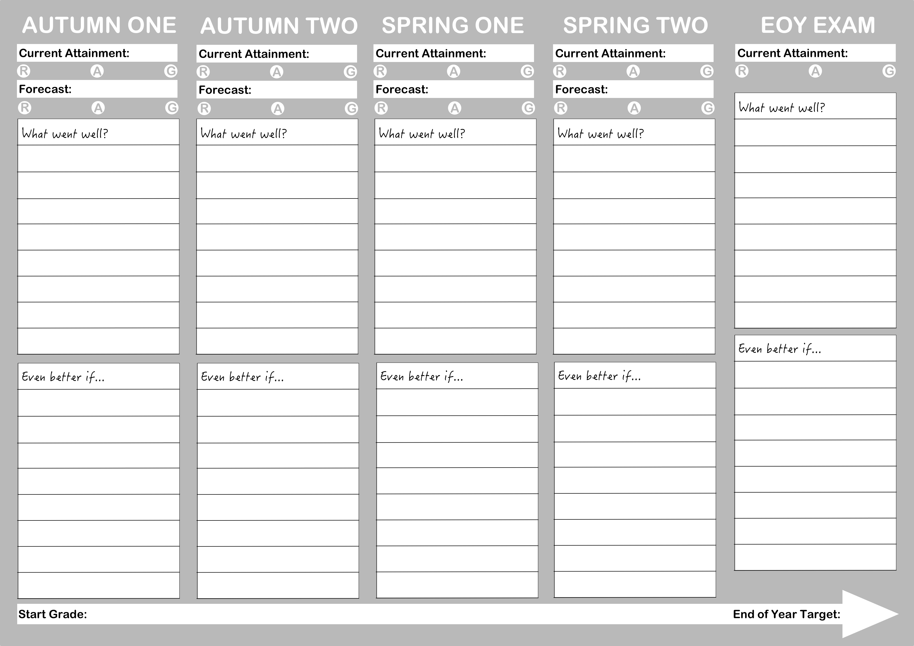
Overview of the Curriculum Assessment Structure

Slide 25
How can I help myself?
Ensure excellent attendance and punctuality
Have a positive attitude to learning- aiming for the best. It is not cool to fail.
Ensure you are ready for learning – equipment, books.
100% attendance to Intervention.
Literacy: lots of Reading (fiction and non- fiction) and watch the news.
Numeracy: practise times tables and mental arithmetic.
Discuss your half-Termly Report (Nov, Jan, Mar, Apr, June)
Talk to your parents about performance Review Meetings & Parents’ Evenings
Any Problems? Please speak to your learning coordinator, Moulana Safvan or any
other staff at school

