Slide 1
What Did The Big Three Want From Versailles?
Georges Clemenceau – Revenge. France had been devastated by the fighting and they needed huge amounts of money to rebuild. Also wanted to cripple Germany both financially and through their army losses so they could never start a war again.
David Lloyd George – Wanted to make Germany pay but was pressured by the British public into being harsher than he wanted to be on Germany. Wanted to gain German colonies and reduce the German navy. Wanted Germany to be able to trade.
Woodrow Wilson – Did not want Germany punished too harshly; he wanted to make sure Europe was stable again economically to make sure another war would not happen. He had the idea for the League of Nations. Wants smaller countries to rule themselves. “Freedom of the seas” – ships can go wherever they want

Slide 2
‘Write an account’ question
This is not a ‘tell me a story’ question.
“Write an account of how the Versailles peace settlement was affected by the fact that the war was mainly fought in France”. (8 marks)
You need to think of it like this: “How did the fact that the war was fought mainly in France affect the Versailles peace settlement?”
The examiners themselves want you to ignore the ‘write an account’ bit. That’s just what the official government education body want them to include.

Slide 3
How to structure your answer
Paragraph one:
The Versailles Peace settlement was affected by the fact that the war was mainly fought in France because Clemenceau was under pressure by…………. There had been much damage such as……… which meant the French people wanted…………………
Paragraph two:
The settlement was also affected by the war being fought mainly in France because Clemenceau wanted to……………. Germany so they couldn’t…………………. This is reflected in the terms about Germany’s military, which meant………………………………..

Slide 4
Model answer
The Versailles Peace settlement was affected by the fact that the war was mainly fought in France because Clemenceau was under pressure by the French people. There had been much damage such as farmland, factories and railways being destroyed, as well as huge loss of life, which meant the French people wanted revenge.
The settlement was also affected by the war being fought mainly in France because Clemenceau wanted to cripple Germany so they couldn’t ever attack France again This is reflected in the terms about Germany’s military, which meant they weren’t able to put troops in the Rhineland and their army had to be reduced to 100,000 men.

Slide 5
Treaty of Versailles
Blame
Reparations - £6.6 billion (mainly to France and Belgium)
Army – 100,000 men, no submarines, no tanks, no air force, 6 battleships
Territory – Rhineland is demilitarised; Alsace-Lorraine goes back to France; lose all of their colonies

Slide 6
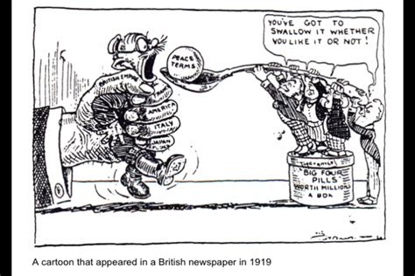
Source B opposes the Treaty of Versailles. How do you know? Explain your answer using the source and your own knowledge. (4 marks)
Source B opposes the Treaty. This is because it shows… This meant the cartoonist felt…

Slide 7
Question 2) Study Sources A and B
How useful are Sources A and B to a historian studying opinions about the Treaty of Versailles?
Refer to the sources and your contextual knowledge.
12 marks.
The usefulness of a source is to do with what it tells you about the event.
Every source is useful but some are more useful than others.
It might reveal something new; people’s opinions; information about the event.

Slide 8
Question 2) Study Sources A and B
Tips:
Look at the date and who the author/artist is. In this case, both are from 1919 but B is from after the Treaty and C comes before. Does this make a difference?
Describe what you see/read and link it to what you know about the Treaty of Versailles.
Remember: this is about opinions of the Treaty of Versailles, not the Treaty itself.

Slide 9
Question 2) Study Sources A and B
How useful are Sources A and B to a historian studying opinions about the Treaty of Versailles?
Refer to the sources and your contextual knowledge.
12 marks.
Checklist for B:
Who drew the cartoon?
Why is Clemenceau being represented as a vampire?
What does this represent about the Treaty of Versailles?
Checklist for C:
Future generations will suffer.
Intentions of the Big Three.
Contextual knowledge:
Terms of the Treaty
How it will affect ordinary Germans

Slide 10
This is a 12 mark question. It will require three paragraphs (in the exam, every four marks will need a new paragraph, roughly speaking)
Source A is useful to a historian studying opinions about the Treaty because it shows……………………………………………. The author of the source is from…………………………. Therefore, it makes sense that they have represented …………………. as a ……………………….. Sucking the life out of a …………………….. woman. This represents the fact that the Treaty took everything from Germany almost to the point of………………………., through the terms such as r……………………………………… and t……………………………….
Source B is also useful to a historian studying opinions about the Treaty. It was written by……. before the Treaty of Versailles was published. He said that……………………………………….. This is useful because it shows not everyone on the ‘winning’ side like Britain supported the Treaty.
Overall, the sources are useful because they show …………………………………… opinions of the treaty. However, this means they are also…………………………………………… because there are also people who ……………………………. The Treaty, which neither of these sources show.

Slide 11
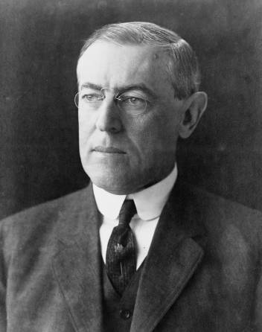
Origins of the League of Nations
Woodrow Wilson was the American President during the First World War. He had tried to keep America out of the war.
However in 1917, with France seemingly on the edge of defeat and American civilians being killed by German submarines, America could no longer stay out of the conflict.
Wilson decided that if America was to join the war, then the object would be to ensure world peace for the future.

Slide 12
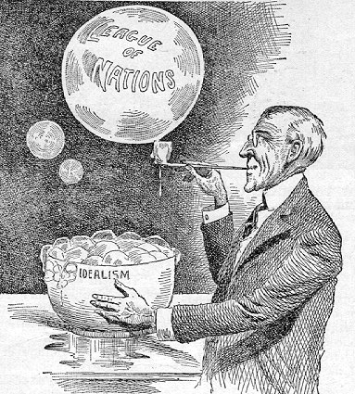
Origins of the League of Nations
Look at this image – What is the cartoonist suggesting about the League of Nations?
Wilson wanted a safer world. He thought having an organization like the League of Nations might stop future conflicts.
It was not a new idea, but after the carnage of the First World War, Wilson’s message of peace and cooperation struck a cord with many people.
People hoped that the First World War would indeed be the “war to end all wars.”
Notes:
Cartoon is from the U.S. publication “The Literary Digest”.

Slide 13
The countries within the League all agreed..
To disarm
If they had a dispute with another country, they would take it to the League
Accept whatever decision was made by the League
To protect one another if they were invaded
If any members did break the covenant and go to war, other members promised to stop trading with it and send troops if necessary.

Slide 14
The Basics – use page 28
What were the four aims of the League of Nations?
How many countries joined?
What did Britain and France think of it?
Some historians have called the League ‘toothless’.
What do you think this means?
Why do you think they have said this?
Do you agree?

Slide 15
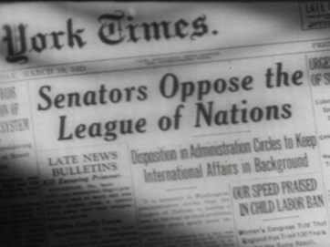
Membership
Surprisingly, America did not join the League of Nations.
Although Wilson was in favour of the League, which had been largely his idea, the American Senate was opposed to it. Wilson unfortunately suffered a stroke in September 1919 and was unable to push his views through.
In addition, Soviet Russia was excluded from the League.
Without the USA or Russia, the League became a largely European organization, dominated by France and Britain.
Neither of these powers were particularly keen to act outside of Europe unless their interests were directly threatened.

Slide 16
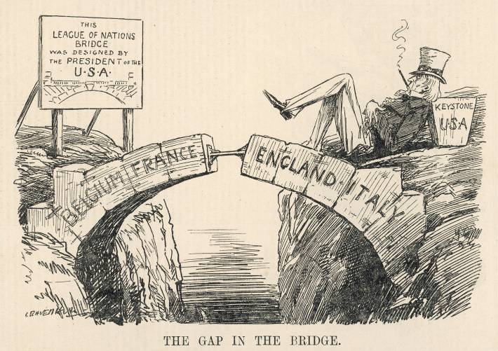
What do you think the cartoonist is trying to say about the League of Nations?
Notes:
Image © Mary Evans Picture Library
Published in Punch magazine in December 1919.

Slide 17
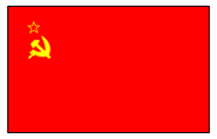
Membership
It was not only the USA and Russia that did not join the League.
Germany and the other defeated powers were barred from joining until they had shown their willingness to abide by the terms of the peace treaties.
Many people saw the League as a “winners’ club”.
As part of the League’s job was to uphold the peace treaties, it often appeared to be acting against Germany and the defeated nations.

Slide 18
Britain and France
Britain and France were the only two major powers continually represented in the League. This meant that in effect, they pretty much ran the League as they wanted to.
However, both countries had suffered terribly during the war. Their economies and armed forces were badly weakened.
This meant that they were usually unwilling to intervene in conflicts when this might cost them money or men.
After the horror of 1914–18, the French and British public were very much against conflict. This meant their governments were unwilling to go to war, even to protect long-term peace.
In addition, Britain and France did not always agree.

Slide 19
Organization of the League
The League’s structure was complicated. This was because there was a lack of consensus about how it should work.
Britain and America did not want the smaller states to have too much power as they feared that the smaller counties would drag them into international disputes that had little to do with them.
France, however, felt that states like Czechoslovakia and Poland needed to be strengthened through inclusion in the League if the peace treaties were to work.

Slide 20
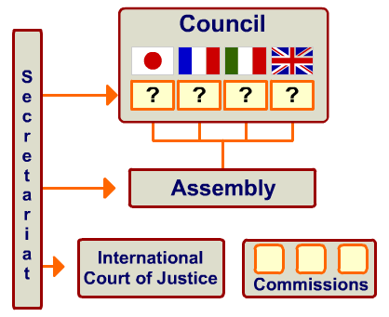
So the structure of the League was a compromise.
The smaller states could have their say in the assembly and through being non-permanent members on the council.
However, as most decisions in the council had to be unanimous, the powers could easily veto any proposals made by the smaller League members.
This meant that the concerns of small countries could easily be ignored if they were inconvenient to the leading members.

Slide 21
Practice question
Other ideas include: couldn’t control its members
Aims were too ambitious
“Structural weaknesses in the League of Nations when it was first set up were the main reason it was doomed to fail.” How far do you agree? Explain your answer.
16 marks plus 4 marks for SPaG
Paragraph 1 – Explain why the structural weaknesses meant it failed
Paragraph 2 – explain another reason e.g. it had no army
Paragraph 3 – explain another reason e.g. America not joining meant actions it took e.g. sanctions were not effective
Conclusion – which of the above is more important?

Slide 22
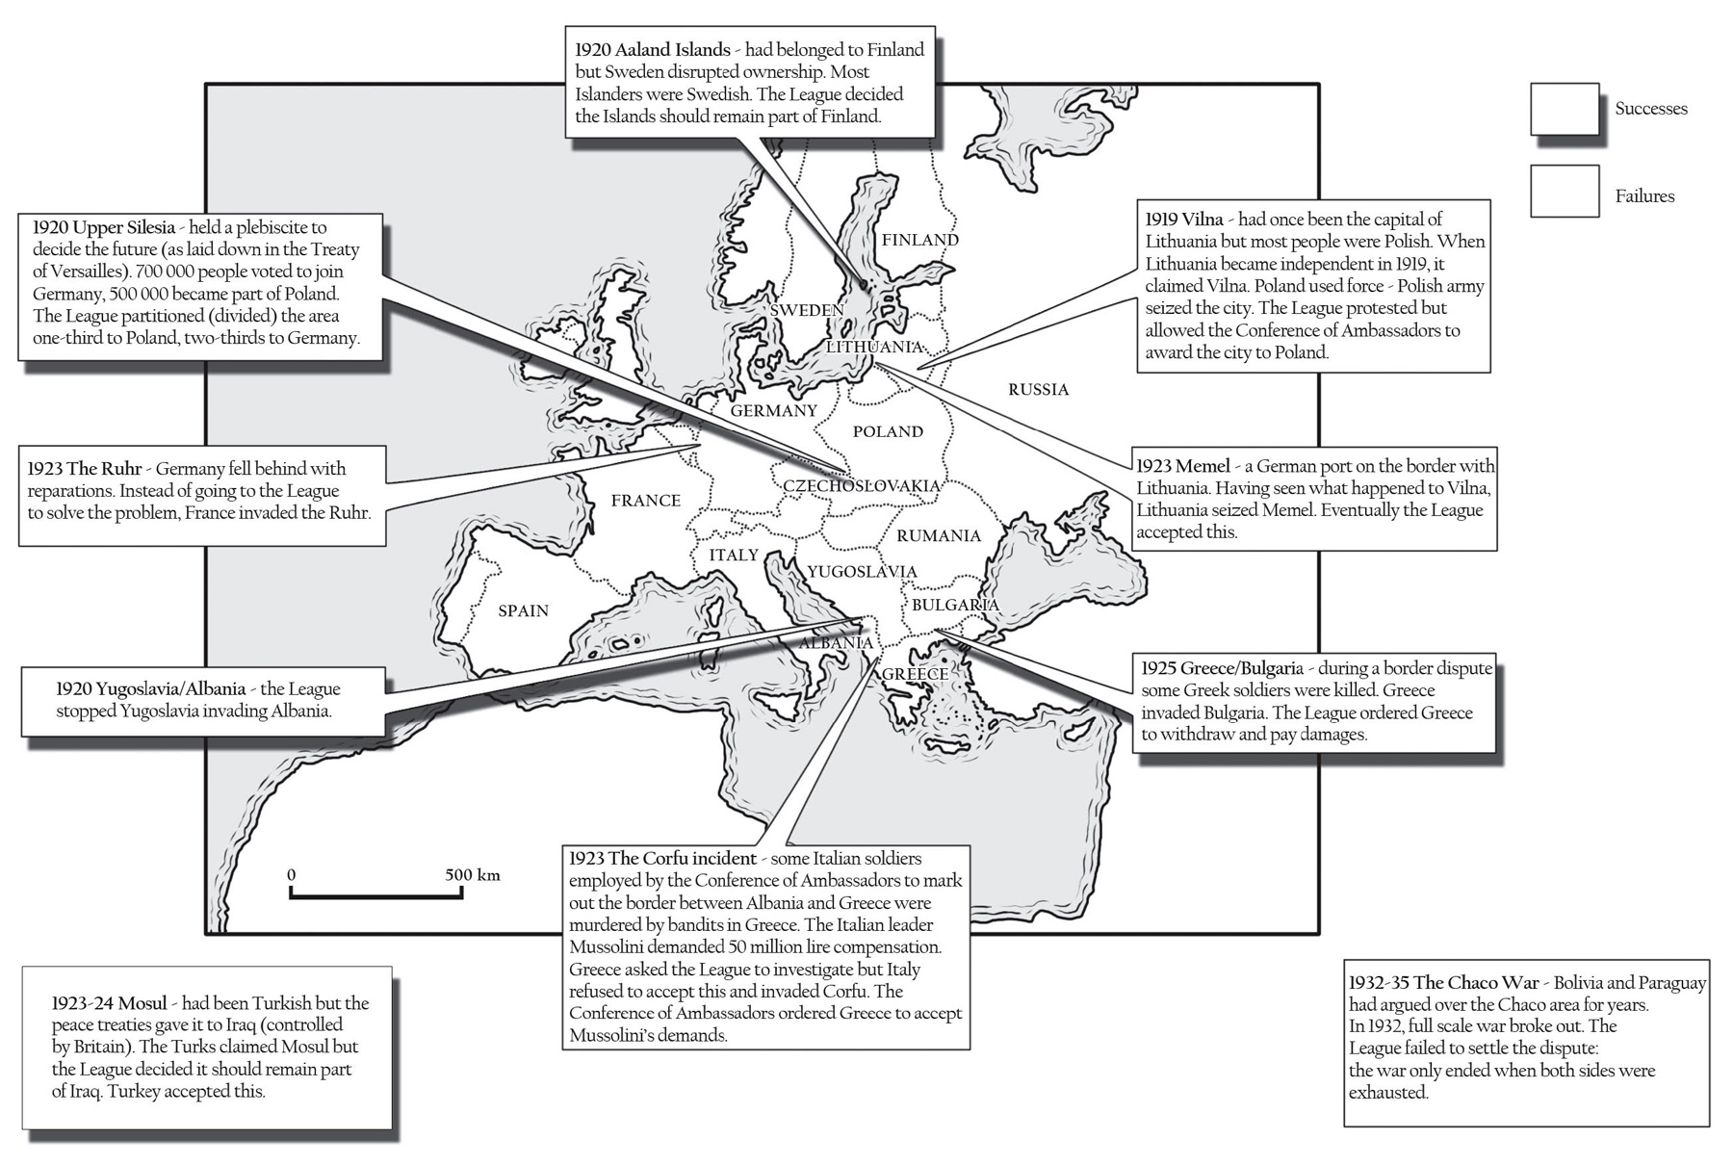

Slide 23
The League of Nations in the 1920s
Turn back to your work on this. You may need to finish it off.
Have a go at the following question:
“The League of Nations failed more often than it succeeded in the 1920s.” How far do you agree with this statement? Explain your answer.
Think about times the League succeeded and failed.
Paragraph one: Agree/disagree and explain why
Paragraph two: Agree/disagree and explain why
Paragraph three: The other side of the argument – this is crucial as a one-sided argument will only get you max 8/16!
Paragraph Four: Conclusion – make reference to both sides and an overall judgement.

Slide 24
The Locarno Treaties, 1925
Which two men were involved? Gustav Stresemann (Germany) and Aristide Briand (France).
How many treaties altogether? Seven.
What did Germany agree to? To settle disputes peacefully.
Who else signed it? Britain, Italy, Belgium and Czechoslovakia.
What would be the consequence? If any of the countries went to war, the others would support the country that had been invaded.
Why did this help Germany? They had feared the ToV left them vulnerable – now they were protected
Why were the Locarno Treaties different to Versailles? An end to resentment and Germany signed them willingly
What did Germany do in 1926? Joined the League of Nations
The Kellogg-Briand Pact, 1928
How many countries signed it? 65
What was the aim of the Pact? To not use war as a way to solve disputes
Which members signed first? Germany, France and USA

Slide 25
Context
In many countries, the 1920s were an exciting time.
People had survived the First World War and life was getting back to normal.
People wanted to celebrate and have fun.
Countries were willing to work together to make sure that these good times never ended.
However, in 1929, the USA was plunged into economic depression and everything changed.
What did this mean for the League of Nations?

Slide 26
Why did chaos come after a booming 20s?
https://www.youtube.com/watch?v=ccNilnpvbJg
Watch the above video
What was life like in the 1920s?
Many new and exciting industries created lots of jobs.
However, in 1929, the Wall Street Crash hit America hard.
Thousands of businesses went bankrupt.
Banks collapsed.
By 1933, 15 million Americans were unemployed.
This crash affected the whole world.

Slide 27
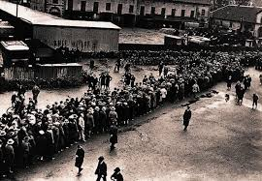
Why did people turn to extremists like the Nazis?
Find out why people started supporting the Nazis – four reasons
Why are authoritarian/extremist governments more likely to cause conflict?
How did the Great Depression affect the League of Nations?
“Thousands of factories closed their doors…All fellow citizens yearned for better times…I had lost all I possessed…I joined the Nazi Party”

Slide 28
Practice question (pg 41)
How useful are Sources A and B to an historian studying the impact of the Depression on Germany? 12 marks.
See page 41 for caption: “Thousands of factories closed their doors. Hunger was the daily companion of the German working man. Many an honest working man had to resort to theft to obtain food. All fellow citizens yearned for better times. As for me, like many another, I had lost all I possessed, so early in 1930, I joined the Nazi Party”

Slide 29
Practice question (pg 41)
How useful are Sources A and B to an historian studying the impact of the Depression on Germany? 12 marks.
Source A is useful because it shows… The Depression caused….. Therefore people….
Source B is also useful because it says….
In conclusion, these sources are completely/partly/somewhat useful because…However, they do not show…

Slide 30
The Manchurian Crisis
Lesson aim :
Explain why Japan wanted to control Manchuria
Learning outcome :
Describe the methods the Japanese army used to take over the area

Slide 31
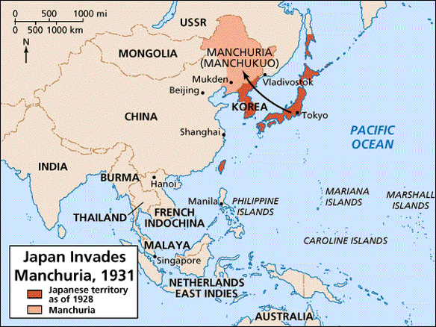

Slide 32
The League’s biggest test so far
Manchuria is a region of China on the north-eastern coast.
It has many natural resources like coal and iron ore.
Japan and Russia had factories there in the 1930s.
Japan was friendly towards the area because of this.
In the 1930s, China was divided and weak.
The country was split into many regions.
The warlords in charge ignored the national government.

Slide 33
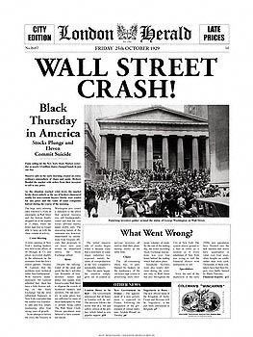
IN 1929, THE AMERICAN STOCK MARKET CRASHED.
The USA stopped buying Japanese goods, so the Japanese silk trade collapsed, so Japan faced unemployment and starvation, so the Japanese became aggressive.

Slide 34
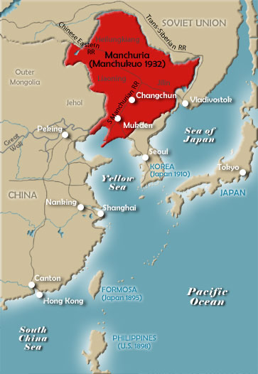
Manchuria had raw materials like coal and iron.
It had farmland.
China was weak.
Japan owned the railway line which went through Manchuria.
Japan already had an army in Manchuria.
Why Manchuria?

Slide 35
What happened? https://www.youtube.com/watch?v=8KdQX7M6q0A

Slide 36
The Mukden Incident
18th September 1931 – there was an explosion on the South Manchurian Railway. The Japanese army said that Chinese soldiers had attacked the train and guards.
China denied this but the Japanese army used it as an excuse to take over.
The government wasn’t happy but had to go along with it.
In 1932, the Japanese renamed Manchuria as Manchukuo. They put had ex-Chinese emperor in charge as a puppet ruler.

Slide 37
The Japanese
blamed the
Chinese.
The Chinese
claimed that they
were innocent.
In 1931 there
was an explosion
on a railway line
at MUKDEN
The Japanese
ignored them and
invaded Manchuria

Slide 38
Explain why the League was not keen to be involved in the Manchurian Crisis. Give at least 2 reasons. The League didn’t want to fight; Too much confusion about what had happened.
Why did economic sanctions not work? USA wasn’t in the League of Nations so continued buying from Japan
Why couldn’t the USSR (Communist Russia) help? They weren’t in the League of Nations
Why couldn’t Britain and France help? Couldn’t afford to send troops so far away
Why did this mean the end of the League? The League had failed – particularly bad as one of its own members had undermined the covenant

Slide 39
Why was the invasion of Manchuria important?
It showed that the League was powerless if challenged by a great power.
It showed that even the most important members of the League could ignore its demands.
It showed how slow the League had been to make decisions.
It set a precedent. From now on, the aggressive powers would see that the League was powerless to act.

Slide 40
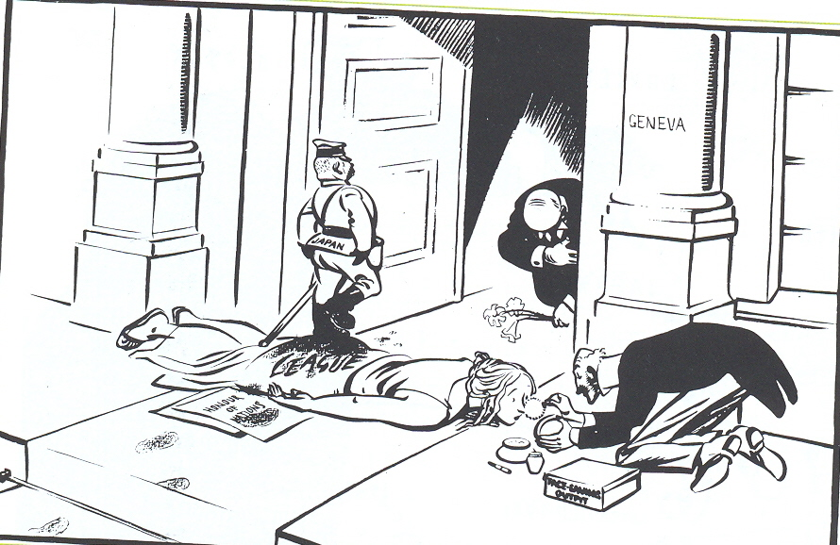

Slide 41
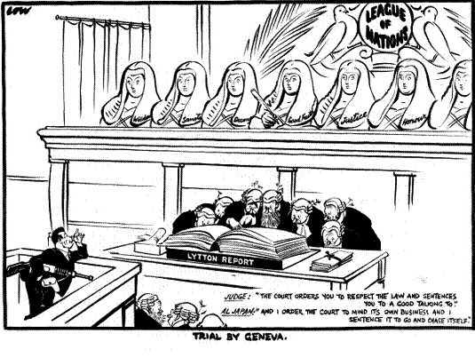
Source A opposes the League of Nations. How do you know? 4 marks.

Slide 42
Write an account of how the invasion of Manchuria became an international crisis. (8 marks).
Paragraph 1:
Explain (briefly) what happened in the event that the question is asking about
Explain why it is important – what could be/ were the consequences/ causes, what changed/ continued?
Paragraph 2:
Explain what happened next/ another cause another change/ continuity?
Explain what impact this had on people or events?
Explain what impact this had on the whole country?
If you have time, do another paragraph with this structure.

Slide 43
The Invasion of Abyssinia

Slide 44
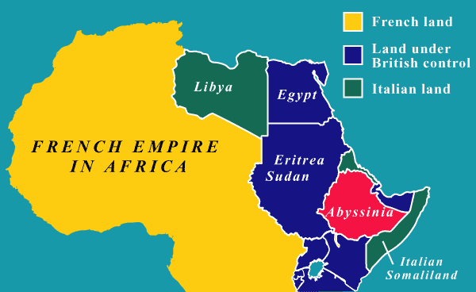

Slide 45
How was the invasion made possible?
After World War One, the people of Italy turned against their government.
Benito Mussolini seized power in 1922.
In the 1930s, the Great Depression hit Italy.
Factories and businesses closed.
Millions lost their jobs.
Mussolini searched for ways to build a new ‘Roman Empire’ and distract his people from hardship.
In 1935, he invaded Abyssinia (modern day Ethiopia).

Slide 46
Adding context
http://www.bbc.co.uk/programmes/p00x6r7w
Write down 4 things that you learn from this video about Mussolini and the invasion:
1
2
3
4

Slide 47
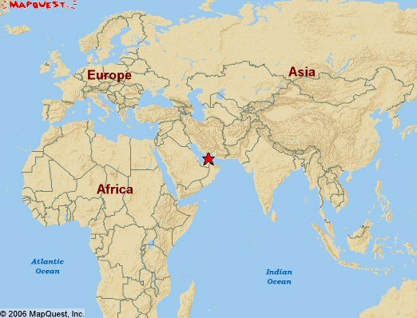
The Suez Canal

Slide 48
Why did Mussolini want Abyssinia?

Slide 49
How did the League respond?
Why was the Suez Canal important? It connected European countries to East Africa and Asia – cut the journey time down
Why wasn’t it closed during the Abyssinian crisis? The British and French wanted to keep Mussolini on side (they were worried about him teaming up with Hitler)
Why did trade sanctions fail? The most important goods like oil, steel, iron or coal, were not on the sanctions list
What were the terms of the Hoare-Laval Pact? Abyssinia would be halved, and they would keep the mountain regions but Italy would get the fertile regions (good for farming)
It didn’t get put into action but there were still consequences. What were they? Outrage against the British and French, and undermining the League’s authority

Slide 50
Practice question
Write an account of why the invasion of Abyssinia became an international crisis (8 marks)

Slide 51
End of the League
The Depression meant people turned to extremist dictators such as Hitler and Mussolini, who were keen to invade other countries. Ultimately, this led to the Second World War, as Hitler invaded more and more countries without the League doing anything to stop him. | America refused to join, and other powerful countries such as Germany and the USSR were not allowed to join when the League was formed. | The League had some very ambitious plans and ideals – to stop war and make the world a better place. However, it could be argued that these plans were too ambitious and didn’t really stand a chance of succeeding. | The League only met once a year, the Council could veto proposals, and decisions had to be unanimous. This made decision-making slow.
The League’s structure was complex and there weren’t enough people to carry out decisions that were made. |  | Powerful countries weren’t scared of moral condemnation, so the League’s sanctions were useless. | The Great Depression meant countries were concerned with their own problems.
Trade sanctions didn’t work because countries could still trade with places such as the USA. | The League was slow to act during the Manchurian Crisis. | The British and French were too worried about keeping Mussolini as an ally against Hitler to stop the Abyssinian invasion. | The League had no army of its own.

Slide 52
Practice question
Source A is useful because it shows… This means that people thought the League of Nations was…
Source B is also useful because it says… This shows that people thought the League of Nations was….
In conclusion, the sources are completely/partly/somewhat useful because… However, they don’t tell us….
“Study Sources A and B” (see page 49). How useful are they for a historian studying opinions about the collapse of the League of Nations? Explain your answer using the sources and your contextual knowledge.

Slide 53
What did Hitler want?
Lebensraum | German term for ‘living space’.
Volksdeutsche | People of the German race.
Anschluss | Uniting Germany and Austria.
Mein Kampf | Book written by Hitler; the title means ‘My Struggle’.
Bolshevism | Another name for Communism, a system of government in which everyone is considered equal.

Slide 54
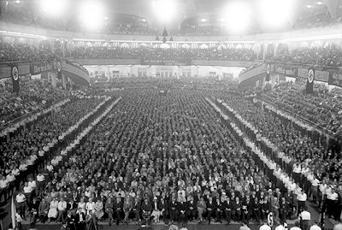
Why did people flock to Hitler?
We can’t deny that Hitler was a very clever man!
He promised the people what they wanted … jobs, food, and their pride back.
Not only did he promise it… he actually did it (even though it wasn’t in the way people expected).

Slide 55
Overturn the Treaty of Versailles
Destroy Communism
United Germany and Austria
Hitler’s aims for Germany
(page 54)
Rearm Germany and create jobs in munitions factories and armed forces
Lebensraum, living space in the east – Hitler wanted the people to have enough land to live on and farm
Unite Volksdeutsche (people with German blood and citizenship) and create a Greater Germany.

Slide 56
Lebensraum – would have to invade other countries who might fight back.
Rearmament – Hitler building a bigger armed forces not only breaks international law (the Treaty of Versailles) but will also make other countries suspicious of his intentions → could lead to war
Reunite German-speaking people and create a Greater Germany – would have to take back land that Germany lost in the Treaty of Versailles but would also have to do things like unite with Austria which is forbidden by the Treaty
Destroy Communism – the USSR (Russia) has a massive army and good relationships (at the moment) with Britain and France. Hitler was provoking a powerful country that would fight back.

Slide 57
Exam practice
Write an account of how Hitler’s foreign policies would lead to war. (8 marks)
One way Hitler’s foreign policies would lead to war is…
Another way is…
How useful are sources C and D to historians learning about Hitler’s foreign policy? Use the sources and your own knowledge (12 marks)
Source C is useful because…
Source D is useful because…

Slide 58
Reactions to Hitler’s policies.
Britain – Prime Minister = Neville Chamberlain. Followed appeasement (giving Hitler some of what he wanted to avoid war). Some, e.g. Winston Churchill, disagreed.
France – President = Eduoard Daladier. France couldn’t do anything about Hitler without Britain’s support. France still in a terrible state after WW1 and the Depression.
USSR – Dictator = Joseph Stalin. Stalin was concerned about Hitler, but also wary of Britain, USA and France. USSR signed a treaty in May 1935 in France, saying the two countries would work together.
USA – President = Franklin D Roosevelt. They followed isolationism – staying out of things that didn’t affect America.

Slide 59
“The main reason other countries failed to react to Hitler’s foreign policy was their fear of war.” How far do you agree with this statement? Explain your answer. (16 marks, SPaG 4 marks)
One reason other countries failed to react to Hitler’s foreign policy was their fear of war. This is made clear by….
However, another reason other countries failed to react was…
Additionally, other countries failed to react because….
In conclusion, the main reason other countries failed to react to Hitler’s foreign policy was……. Because……………. Other reasons, such as …… and…… were important, but not as important as.

Slide 60
1933 League of Nations Disarmament Conference - Hitler said he would disarm if other countries did. France refused. Germany left the League of Nations and started to rearm.
1934 – The Austrian Chancellor, Dollfuss, banned the Nazi Party in Austria. Hitler told Austrian Nazis to cause havoc. Some of them murdered Dollfuss. Hitler distanced himself from this.
13th January 1935 – The Saar Plebiscite – the people living in the area of the Saar voted to rejoin Germany. He used the coalfields to power his rearmament.
March 1935 – Rearmament – “Freedom to Rearm” rally in 1935. Hitler showed off lots of weapons he had secretly been building.
April 1935 – Stresa Front – Agreement between France, Britain and Italy to stop Hitler from breaking any more Treaty of Versailles.
June 1935 – Anglo-German Naval Agreement – Britain said that Germany could build a navy to 35% of the British one. Hitler saw this as Britain saying that the TOV was unfair so Germany could ignore it.

Slide 61
Plenary – Practice Question
Write an account of how Hitler broke the terms of the Treaty of Versailles.
(8 marks).
One way in which Hitler broke the terms of the Treaty of Versailles was…
Another way Hitler broke the terms of the Treaty of Versailles was…

Slide 62
The Invasion of the Rhineland

Slide 63
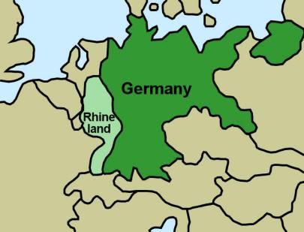
What was significant about the Rhineland?
Under the terms of the Treaty of Versailles and the Locarno Treaties, the Rhineland belonged to Germany but it was to be free from military presence.
This was to protect France from any future invasions from Germany.

Slide 64
Lebensraum – What was this?
Hitler knew that to gain Lebensraum in the East, he would have to invade other countries.
He knew this would provoke a response from Britain and France.
He had to protect Germany’s western borders, so the remilitarisation of the Rhineland was key to this.

Slide 65
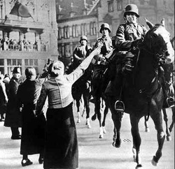
How did people in the Rhineland respond?

Slide 66
Why didn’t other countries react?
Britain
Many Britons felt Germany had the right to protect their borders.
British troops were busy dealing with the invasion of Abyssinia.
The Depression hit Britain hard; the nation couldn’t afford to intervene abroad.
Many believed Hitler was reclaiming what was his.
France
Politicians in France were fighting a general election.
Plunging into a war would lose them votes.
Much of the French army were stationed in Tunisia should the situation in Abyssinia worsened.
French generals overestimated the size of the German army entering the Rhineland – they weren’t prepared to risk their men.

Slide 67
Britain | Hitler suggested a non-aggression pact with Britain | 1936 | No | Some British wanted to cooperate with Hitler to avoid/postpone war. They needed time to rearm and recruit.
Italy | Rome-Berlin Axis – an agreement to work closely together | 1936 | Unofficial | Mussolini no longer felt isolated in Europe and that he had an ally if a country declared war on him.
Spain | Hitler sent troops and weapons to help General Franco in Spain | 1936 | Yes | Franco was able to defeat the Republicans and essentially owed Hitler one!
Japan | Anti-Comintern act – an agreement to fight communism | 1936 | Yes | Japan signed this pact hoping that China would feel threatened and surrender.
Italy + Japan | Pact of Steel – armies would work together | 1939-1940 | Yes | Italy signed up in 1939 Japan signed up 1940

Slide 68
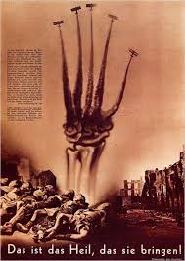
Study Source A
Source A opposes Hitler’s involvement in the Spanish Civil War. How do you know? Explain your answer using the source and your own knowledge.

Slide 69
Background
http://www.bbc.co.uk/education/clips/zmt7tfr
The Rhineland and Anschluss
Hitler had already attempted to join Germany and Austria in 1934.
There was a strong and loyal Nazi Party in Austria.
They had murdered the Austrian leader during an attempted takeover.
A major factor in their failure was that the Italian leader, Benito Mussolini, stood up to Hitler.
With the signing of the Anti-Comintern Act and their mutual support for General Franco in the Spanish Civil War, Hitler had another attempt.

Slide 70
Hitler was born there.
Shared a language and similar cultures.
Austria had ruled Germany for 600 years.
Why did Hitler want to unite with Austria?
Hitler could achieve one of his foreign policy aims: unite all German speaking people in a Greater Germany
United in World War 1

Slide 71
Austria – most people in Austria in favour of Anschluss and Hitler’s leadership as they think it will make Austria great again.
However, Austria was home to 180,000 Jews. They know Jews in Germany are persecuted so think this will happen to them. After the Nazis invaded, Jews are arrested at random, imprisoned, or forced to scrub streets/public toilets with their sacred prayer cloths.
Thousands of Jews leave Austria.

Slide 72
Germany – Germany was stronger and Hitler had made another step towards uniting German speakers and overthrowing ToV. Austria also had lots of steel and iron. Also, a massive propaganda success.
Britain – Most in Britain feels Austria and Germany are essentially the same country so should have the right to unite. Some, like Churchill, think if Austria wanted to, Germany should have negotiated rather than sending in troops.

Slide 73
France – has its own political problems. 2 days before Anschluss, the whole French government had resigned because of unrest due to economic issues.
Czechoslovakia – Afraid when they heard the news. They think they’ll be next. Turned to Britain and France who promised to protect them if Germany invade.

Slide 74
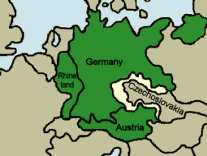
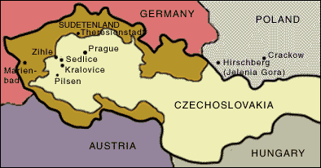

Slide 75
Why did Hitler want the Sudetenland?
Czechoslovakia had been created from taking German land after WW1 – Hitler wanted it back
It had many forts, factories, railways, and industries – Hitler could use this for rearmament
It was home to 3 million Germans – they said they were being persecuted by the government – Hitler wanted to ‘save’ them
It would be a good base to attack and take over the rest of Czechoslovakia

Slide 76
Important dates
15th September 1938 – Chamberlain flew to Hitler’s holiday home. Hitler said war could only be avoided by giving him the Sudetenland. Chamberlain was so desperate for a peaceful solution so agreed.
Chamberlain met the Czechs and forced them to agree.
22nd September 1938 – Chamberlain returned to meet Hitler. Hitler changed his demands. He wanted the Sudetenland by 1st October and said Hungary and Poland should also receive Czech land.

Slide 77
Write an account of how events in the Sudetenland became an international crisis (8 marks)
Hitler wanted the Sudetenland because it was home to three million Germans. They claimed they were being persecuted by the Czechoslovakian government and Hitler wanted to save them.
One reason events in the Sudetenland became an international crisis was because Hitler was threatening to invade the Sudetenland. Chamberlain flew to meet Hitler in September in 1938. Chamberlain’s aim was to make an agreement that would avoid war. Hitler demanded to annex the Sudetenland and if Britain didn’t agree he would invade anyway.
Another reason it became an international crisis was that after Chamberlain got Czechoslovakia to agree (reluctantly), Hitler demanded that he get it sooner. Even after this, he wanted more and invaded the rest of the country. Other countries such as Hungary and Poland were worried because they thought they would be next. All signs were now pointing to war and Britain threatened to declare war on Germany if they invaded Poland.

Slide 78
Plenary
Write an account of how Britain appeased Hitler in the 1930s. (8 marks).
One way Britain appeased Hitler in the 1930s was…
Another way was….

Slide 79
Context
During the late 1930s, the British followed a policy of appeasement. This meant that the British government was prepared to go to almost any lengths to avoid war.
Neville Chamberlain’s use of appeasement has been argued about by lots of historians.
Some support it, saying that it was the only responsible thing to do
Others claim that if Britain and France had acted while Hitler was still weak, then war would have been avoided.

Slide 80
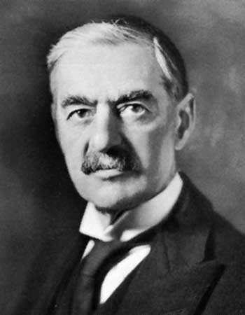
Neville Chamberlain – 1869-1940
Neville Chamberlain was born in Birmingham.
His father was a politician.
His half-brother, Austen, held many positions with Conservative governments of the early 20th Century.
In 1915, Chamberlain became lord mayor of Birmingham.
In 1918, he became the Conservative MP for Birmingham.
1923 – Chancellor of the Exchequer
1914 – Minister of Health
1937 – he became Prime Minister.

Slide 81
Many people felt the Treaty of Versailles had been too harsh and thought it was only fair to overturn parts of it e.g. rearm and remilitarise the Rhineland
Hitler kept telling the British he was a man of peace
Everyone wanted to avoid the horrors of another war
Threat of Communism worried people more than Hitler. A strong Germany would prevent communism spreading.
People misjudged Hitler and missed opportunities to stop him e.g. the Rhineland
Appeasement was morally wrong and left countries like Czechoslovakia occupied by the Nazis
The more Hitler got away with the more confident he grew
Appeasement alienated the USSR who were worried about being left alone without support if Hitler invaded them
http://www.bbc.co.uk/education/clips/zvryr82
Add to your argument using the information from this clip.

Slide 82
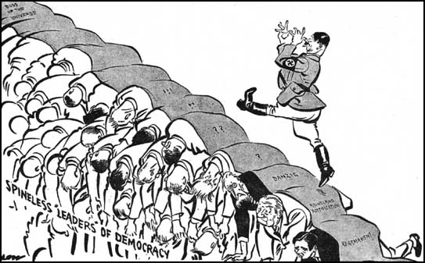
“We are not interested in breaking peace. I am thankful to Mr Chamberlain for all his trouble and I assured him that the German people want nothing but peace, but I also declared that I cannot go beyond the limits of our patience. I further assured him, and I repeat here, that if this problem is solved, there will be no further territorial problems in Europe for Germany.”
Adapted from a speech given by Hitler in 1938.

Slide 83
Exam practice
“The policy of appeasement was a mistake that led to the outbreak of the Second World War.” How far do you agree with this statement? Explain your answer. (16 marks, SPaG, 4 marks).
Paragraph one: It can be argued that appeasement was a mistake that led to the outbreak of world war 2.
Another reason it can be seen as a mistake is…
However, it can be argued that it was not a mistake because …
In conclusion, I agree/disagree with the statement because…

Slide 84
Nazi Soviet Pact
Both USSR and Germany wanted Poland – it had been a new country created at end of WW1 from Russian and German territories.
Hitler sent his foreign minister to make a deal – if USSR allowed Hitler to invade Poland, the USSR would be given Polish territory.
23rd August 1939, both countries signed a non-aggression Pact.
To prevent a war on two fronts. H | Britain and France would not protect them; they needed a new ally. S | To give time to rearm. S | Britain and France did not seem to value them as an ally. S
To gain territory, without having to fight. S | Poland could provide Lebensraum but the USSR might prevent this. H | Poland could act as a buffer to stop attacks from the west. S | Poland had been created from land taken from them at the end of the First World War. H

Slide 85
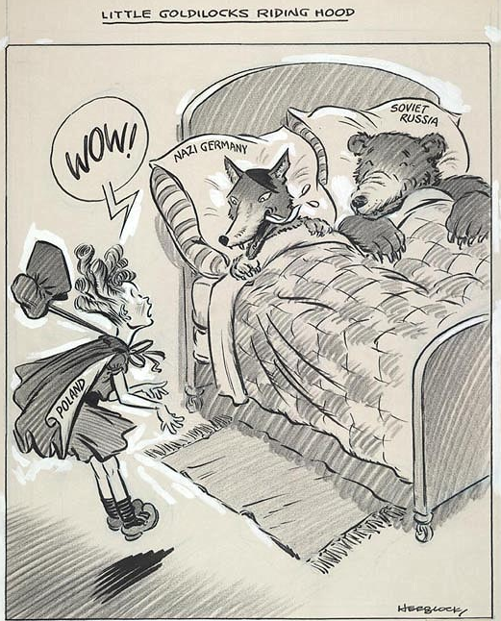
How useful are sources E and F to a historian studying why Russia signed the Nazi-Soviet Pact? Explain your answer using Sources E and F and your own knowledge (12 marks)
Source E
“We secured peace for our country for eighteen months, which enabled us to make military preparations.”
Stalin speaking in 1941, after Hitler invaded Russia, about why he signed the Nazi-Soviet Pact
Source F

Slide 86
Exam practice
“The policy of appeasement was a mistake that led to the outbreak of the Second World War.” How far do you agree with this statement? Explain your answer. (16 marks, SPaG, 4 marks).
Paragraph one: It can be argued that appeasement was a mistake that led to the outbreak of world war 2.
Another reason it can be seen as a mistake is…
However, it can be argued that it was not a mistake because …
In conclusion, I agree/disagree with the statement because…

Slide 87
The invasion of Poland and the Declaration of War

Slide 88
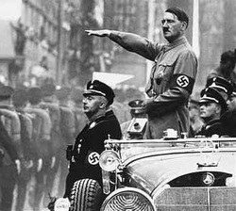
Background
The major aim of the League of Nations had been to create lasting peace.
Throughout the 1930s, Britain and France followed the policy of appeasement to avoid major conflict.
However, on the 1st September 1939, Nazi troops entered Poland. Two days later, Britain and France declared war.

Slide 89
Putting it all together – the outbreak of the Second World War
Take your handout of the Causes of the Second World War.
In threes or fours, pick your top 8 reasons for the outbreak of the Second World War. Circle these in one colour.
Individually – examine these 8 causes. Narrow them down to the three most important causes in your opinion.

Slide 90
Putting it all together – the outbreak of the Second World War
“The Nazi-Soviet Pact was the main reason for the outbreak of the Second World War in 1939” How far do you agree with this statement? Explain your answer 16 marks SPAG 4
P1 – Explain why the Nazi-Soviet Pact led to the second world war
P2 – Pick another reason – explain as above
P3 – Pick another reason – explain as above
P4 – In conclusion I think (top level answers will explain links between the causes)

